Slide 1
Mobile Web
Christopher Harrison
Jeremy Foster

Slide 2
Course Topics
Mobile Web
01 | Designing for Mobile | 05 | The Mobile Client
02 | Mobile UI | 06 | Offline Data
03 | Integrating Touch | 07 | Publishing to Azure
04 | Setting Up the Server
Notes:
jeremy

Slide 3
02 | Mobile UI
Christopher Harrison | @GeekTrainer
Jeremy Foster | @codefoster
Notes:
Really, styling and layout are not entirely exclusively defined and we use CSS properties to affect both, but basically styling is changing the look of things – the colors, the fonts, the sizes, etc. Layout, on the other hand, is more a matter of where on the screen things appear, how much space there is between things, and how things behave when the screen is resized or reoriented by the user.

Slide 4
Module Overview
CSS and media queries
Bootstrap
Images
Mimicking Apps

Slide 5
CSS and media queries

Slide 6
30 second CSS review
Cascading style sheets
Higher precedence for best matches
ID
Class
Element
Last write wins

Slide 7
Browser detection
Challenging at best
User agent strings can be misleading
User agent strings can be spoofed
Use a library
UA.js
https://github.com/g13n/ua.js

Slide 8
Browser Capability Detection
What the browser is doesn't matter
What matters is what features it supports
Modernizr
Open source library
Adds classes based on browser capabilities
feature (if supported)
video
feature (if not supported)
no-video

Slide 9
modernizr

Slide 10
Media queries
Specify different settings based on
Device type
State
Screen size

Slide 11
Device types
Screen
Print
Projector
Handheld
Don't use
Won't test as positive for most tablets
Doesn't give us enough information

Slide 12
Orientation
Portrait
Landscape

Slide 13
Size
Width and height
Size of the current window
Device-width and device-height
Size of the current device
Max and min modifiers

Slide 14
Using media queries
Remember cascading rules
Higher precedence to best match
Media query sections override generic rules
Ordering matters
Put global rules first
Smallest to largest or largest to smallest

Slide 15
Media queries

Slide 16
Bootstrap

Slide 17
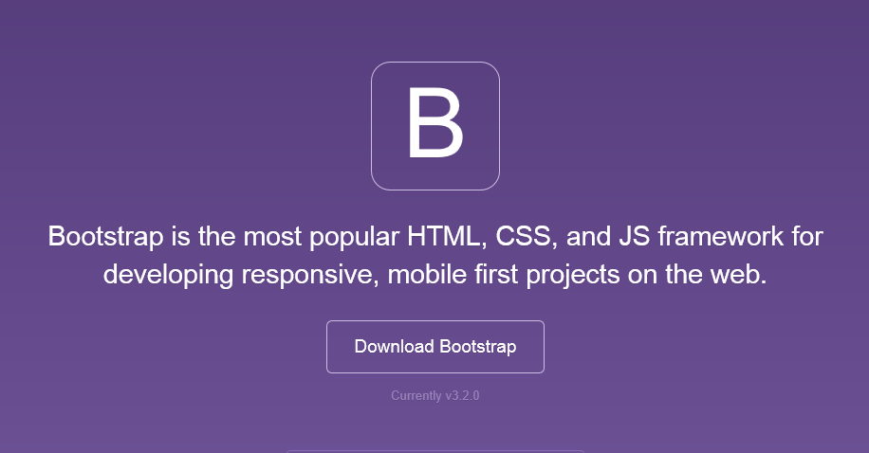
Bootstrap
The most popular front-end framework for developing responsive, mobile first projects on the web.

Slide 18
Bootstrap Features
Theme Support
Responsive
Grid
Components
Pagination
Buttons
Modal
Great Visual Studio support

Slide 19
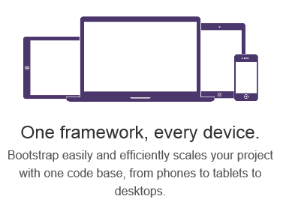
Responsive Layout

Slide 20
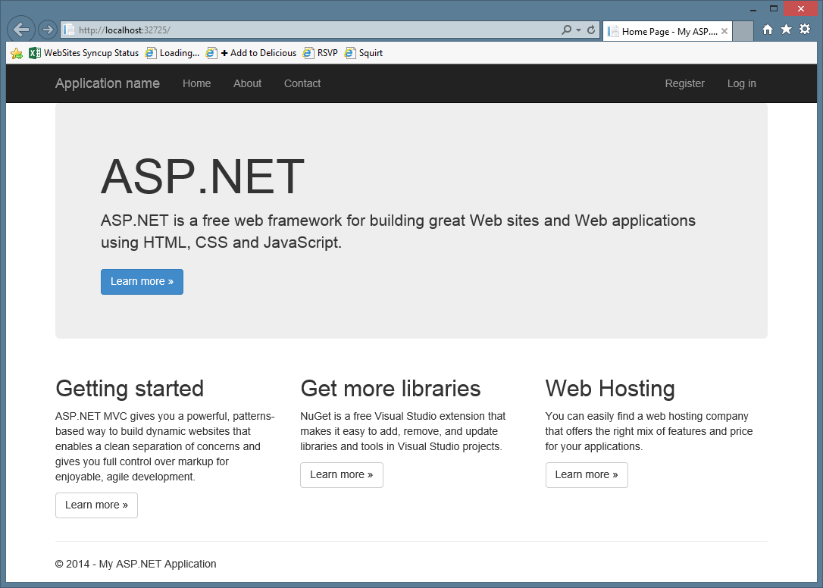
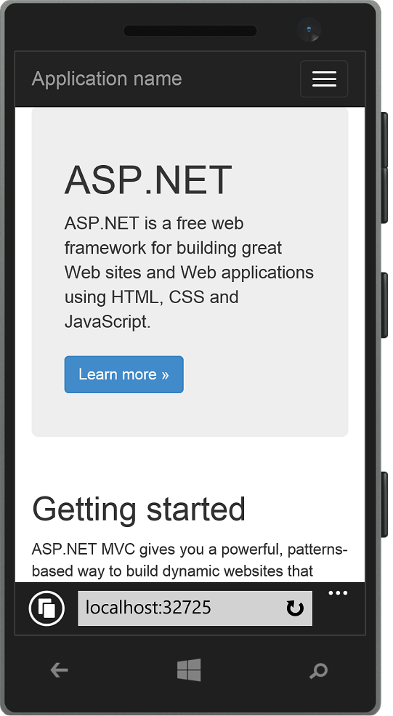
Responsive Layout

Slide 21
Bootstrap and mobile devices

Slide 22
Images

Slide 23
What not to do F12 tools

Slide 24
Image issues
Need to send down right sized images
Servers don't automatically resize images
img tag doesn't support size detection

Slide 25
Option one
SVG graphics
The name says it all
Scalable
Vector
Graphics
Images are created declaratively
Least amount of data to be downloaded
Potential issues
Browser support
Generating SVG

Slide 26
A simple SVG

Slide 27
Option two
HTML5 picture element
W3C draft standard
Similar to audio and video elements
Specify multiple images
Supports media queries
Potential issues
Browser support
Scott Jehl's picturefill: https://github.com/scottjehl/picturefill

Slide 28
Picture element
http://www.html5rocks.com/en/tutorials/responsive/picture-element/

Slide 29
Option three
Background images on div tags
Always works
Supports media queries
Potential issues
It's a hack

Slide 30
Background images

Slide 31
Mimicking apps

Slide 32
Just because it's not an app...
Doesn't mean we don't want it to behave like one
Components
Controlling the browser
Shortcut icon

Slide 33
Controlling the browser
viewport meta tag
Set zoom capabilities
Hiding the address bar
https://gist.github.com/scottjehl/1183357
(iOS and Android only)

Slide 34
Icons
Determine what is placed on home screen when "installed"
Unfortunately, each vendor has their own method
http://en.wikipedia.org/wiki/Favicon

Slide 35
Mimicking live tile
Live tiles show state of an application
Unread messages
Number of posted updates
Using polling, pinned sites can behave like live tiles
Full details:
http://msdn.microsoft.com/en-us/library/ie/dn455115(v=vs.85).aspx
Scott Hanselman's blog:
http://www.hanselman.com/blog/MakeAWindows81PinnedLiveTileForYOURWebsiteInMinutes.aspx
Build My Pinned Site
http://www.buildmypinnedsite.com/

Slide 36
Live tiles

